Slide 1



Deep learning for multi-class skin lesion diagnosis
Fábio Miguel Tomaz dos Santos
Supervisors: Filipe Silva, Pétia Georgieva
21/07/2020
Notes:
Good afternoon
Im fábio and im here to present my dissertation titled “deep learning for multi-class skin lesion diagnosis”
It is very exciting for me to be finally presenting this work towards all of you and i hope you enjoy it.
I would like to personally thank professor Filipe Silva and professor Pétia Georgieva for all the support and guidance given throughout this work. Without them this work wouldn’t be possible.

Slide 2
Structure
Motivation and Objectives
CNNs and Transfer Learning
Experimental Setup
Pre-trained Model Choice and Hyperparameter Tuning
Improving the Model’s Generalization Performance
Results Discussion and Comparison
Conclusion
Notes:
This presentattion is going to be structured as folllows:
I will start out by talking about the background and objectives behind this dissertation;
I will provide some context about cnns and transfer learning,
Then, describe the experimental setup,
Afterward, i will present some of this work’s experiments and discussions about the results
I will finish this presentation with final remarks and future research points

Slide 3
Background and Motivation
The International Skin Imaging Collaboration challenges provides a benchmark for comparison of skin lesion classifiers:
Yearly challenges since 2016
The problem is not solved!
Convolutional Neural Network (CNN) models present state-of-the-art performance in these type of challenges
Several Limitations prevent these models from achieving better generalization performance:
Data limitations
Hardware limitations
Divergent train and test set distributions
Notes:
Ever since 2016, the International Skin Imaging Collaboration (or ISIC) provides yearly benchamrk challenges for the classification of skin lesions in order to further extend the current SOTA results in this domain.
These challenges are a prime example of the success of deep learning models, more specifically CNNs, as seen in the literature.
However, several limitations have been pointed out by some authors which prevent these models from achieving better generalization performance
Mainly related to data and hardware.

Slide 4
Objectives
To respond to the ISIC 2019 challenge by studying methods to improve the generalization performance of classifiers of multiple types of skin lesions
To focus on Convolutional Neural Network (CNN) architectures and transfer learning as well as the impact of (8-class classifier):
Data augmentation
Class balancing
Ensemble learning
To compare different strategies to identify out of training distribution samples from the test set (9-class classifier)
Notes:
Taking these limitations into consideration, this work aims to respond to the ISIC 2019 challenge by improving the generalization performance of a skin lesion classifier which is able to classify multiple types of skin lesions
For this purpose the objectives were to study different transfer learning methodologies, and the impact factors like data augmentation, class balancing and ensemble learning techniques.
Furthermore, the ISIC comitee noted from previous versions of this challenge that the detection of samples which are not part of the original training distribution should become a research focus for this year’s challenge. Therefore. One of this work’s objectives is to experiment with different strategies to identify out of training distribution samples from the test set

Slide 5
Structure
Motivation and Objectives
CNNs and Transfer Learning
Experimental Setup
Pre-trained Model Choice and Hyperparameter Tuning
Improving the Model’s Generalization Performance
Results Discussion and Comparison
Conclusion
Notes:
So we are going to contextualize CNNs and transfer learning for this work...

Slide 6
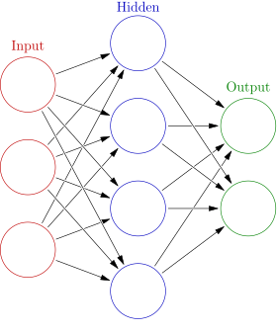
Artificial Neural Networks and Deep Learning
Artificial Neural Network (ANN):
Input layer, hidden layer, and output layer
Layers composed by neurons
Activation functions (e.g., ReLU, softmax)
Optimization strategy to minimize the loss (e.g., SGD, Adam)
Loss function (e.g., cross entropy loss)
Deep neural network:
More hidden layers
Can build levels of abstraction
No need for feature engineering
Notes:
Convolutional neural networks or CNNs are based on Artificial Neural Networks or ANNs
ANNs are usually composed of… each composed by a set of neurons
A neuron can be mathematically described as….
An input x
An matrix of learnable weights w
An bias b
An activation function g such as the ReLU
Parameters are learned using an optimization strategy such as Adam and these aim to decrease a loss function such as the cross entropy loss
An improvement towards ANNs are Deep Neural Networks

Slide 7

Convolutional Neural Networks (CNNs)
Deep learning topology
Used for image classification problems
Structure:
Convolutional base
Classifier
Distinguishing concepts:
Local receptive fields - local features
Shared weights - translation invariance
Pooling layers - information summary
Notes:
However, Convolutional Neural Networks is usually used for image classifcation problems and they have the inherent ability to extract features from images. Their structure is composed of 2 components:
The convolutional base which is composed of convolutional layers and pooling layers capable of extracting features and the classifier which translates those features into a classification label.
Moreover, there are 3 main concepts that distinguish CNNs from normal ANNs, namely:
….

Slide 8
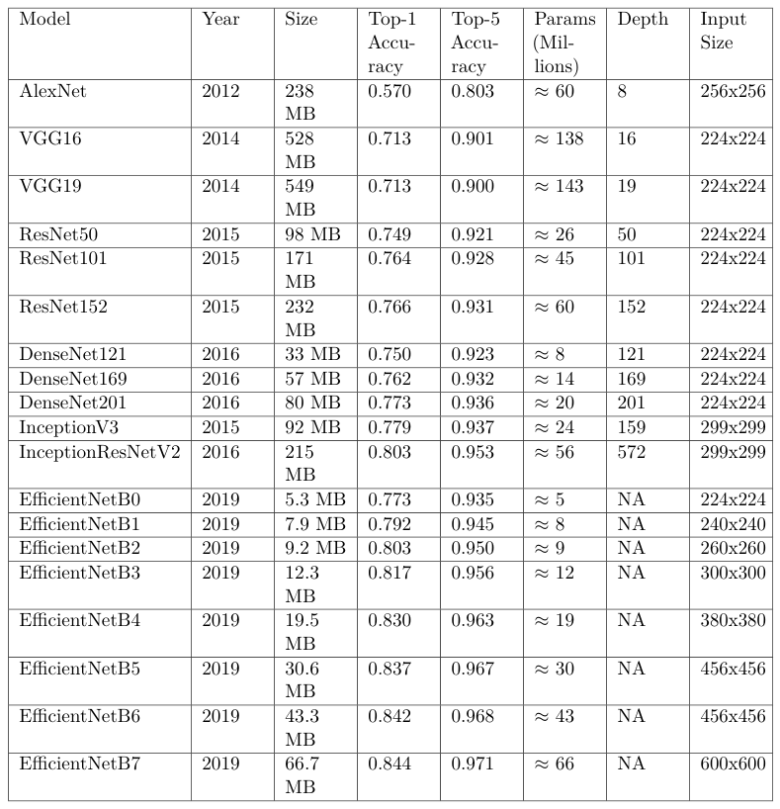
CNN Architectures
AlexNet: CNN breakthrough
VGG: representational depth leap
ResNet: solved the vanishing gradients problem
DenseNet: extended ResNet concepts
Inception: Highly engineered architecture
EfficientNet: Compound scaling method
Notes:
Over the years, several CNN architectures have been proposed to address benchmark challenges such as the ILRSVC in which participants are asked to improve performance of their models against the ImageNet dataset.
The ImageNet is a generic dataset composed of Millions of samples spread accross thousands of classes such as objects and animals.
You can observe some of the most popular SOTA CNN architectures in this table on the right side:
One can see that more recent architectures outperform older ones while being considerably smaller.
Furthermore, these models have an increasing depth and input size as time gone by.
Finally, im not going to dive into details about these architectures but you can get further descriptions in both this dissertation’s document and in a paper that is going to be presented at this year’s I triple E Inteligent Systems Conference which is a product of the literature review of this work.

Slide 9
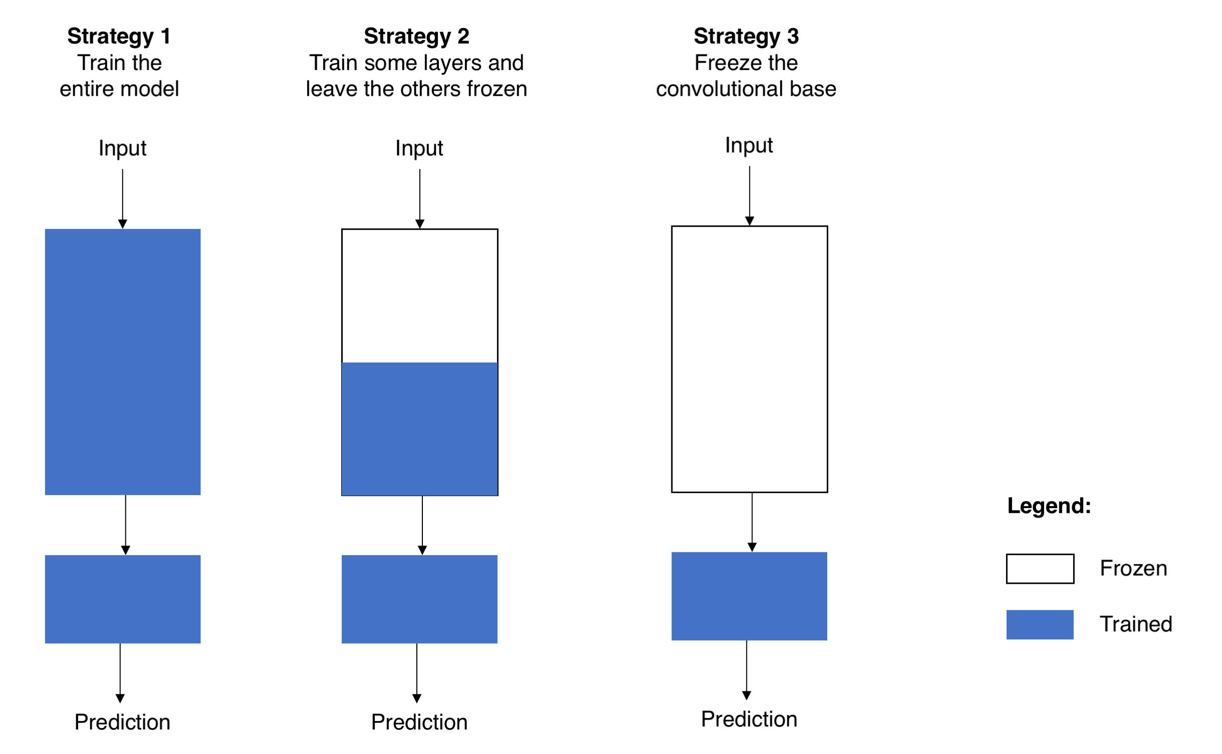
Transfer Learning
Reusing a pre-trained model’s knowledge for another related task
Alleviates the lack of data;
Replace the classifier;
Different strategies to deal with the convolutional base:
How large is the dataset?
How similar are the datasets?
What is the available computational capability?
Notes:
The reason…
Finally, by using transfer learning we explored most of these architectures on our experiments.

Slide 10
Structure
Motivation and Objectives
CNNs and Transfer Learning
Experimental Setup
Pre-trained Model Choice and Hyperparameter Tuning
Improving the Model’s Generalization Performance
Results Discussion and Comparison
Conclusion
Notes:
We are now going to describe our data and conditions used for our experiments

Slide 11
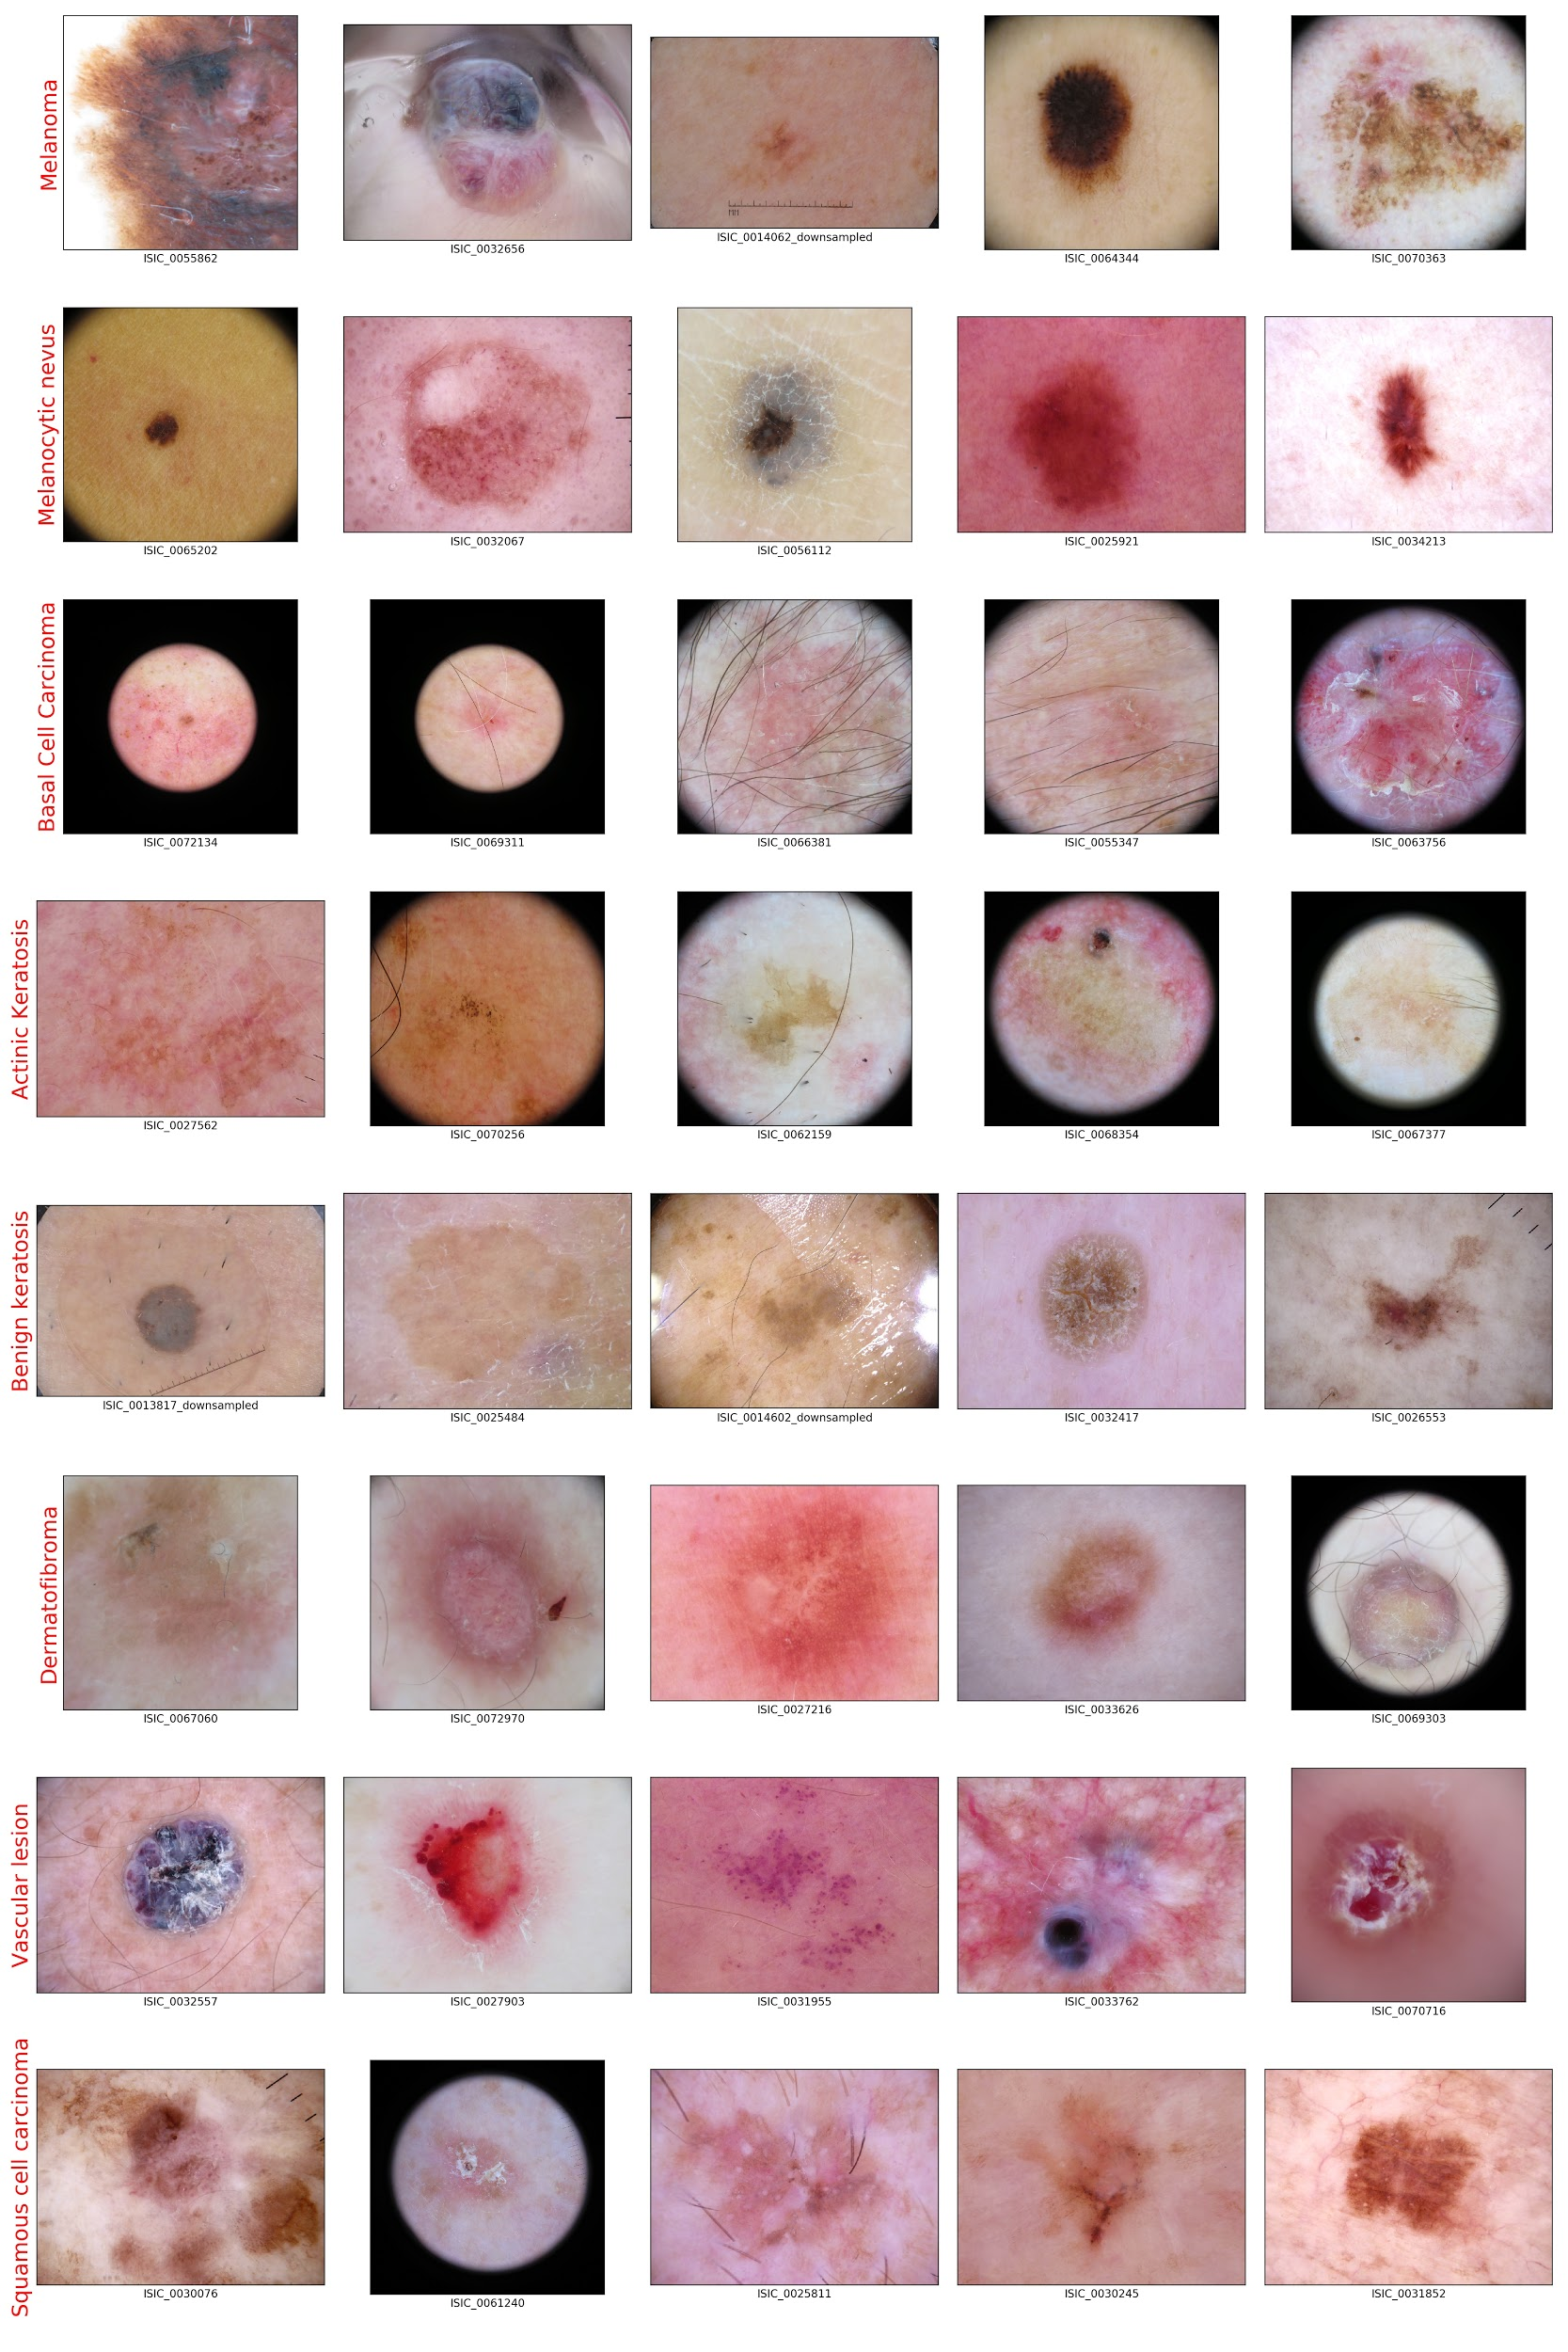
ISIC 2019 Dataset
Contains 8 classes:
Melanoma (MEL)
Melanocytic nevus (NV)
Basal cell carcinoma (BCC)
Actinic keratosis (AK)
Benign keratosis (BK)
Dermatofibroma (DF)
Vascular lesion (VASC)
Squamous cell carcinoma (SCC)
Pre-processing: cropping, resizing, normalization
Train, validation and test split
Same validation & test sets across experiments
Notes:
The provided ISIC 2019 training dataset contains near 25000 samples spread across 8 different classes. Some of these samples can be observed in the right slide of this slide. You can likely see that samples are very different from each other even within each class, which just goes to show how difficult is this classification problem.
In order to ease the training process some pre-processing methods are used before training, namely:
However, because the ground truth of the ISIC 2019 challenge test set is not provided we had to gather our own test set.
In this context, we used the holdout method with approximately a 80 10 10 split.
We always use the same sets accorss the experiments which improves consistency and reproduçability of the results.

Slide 12
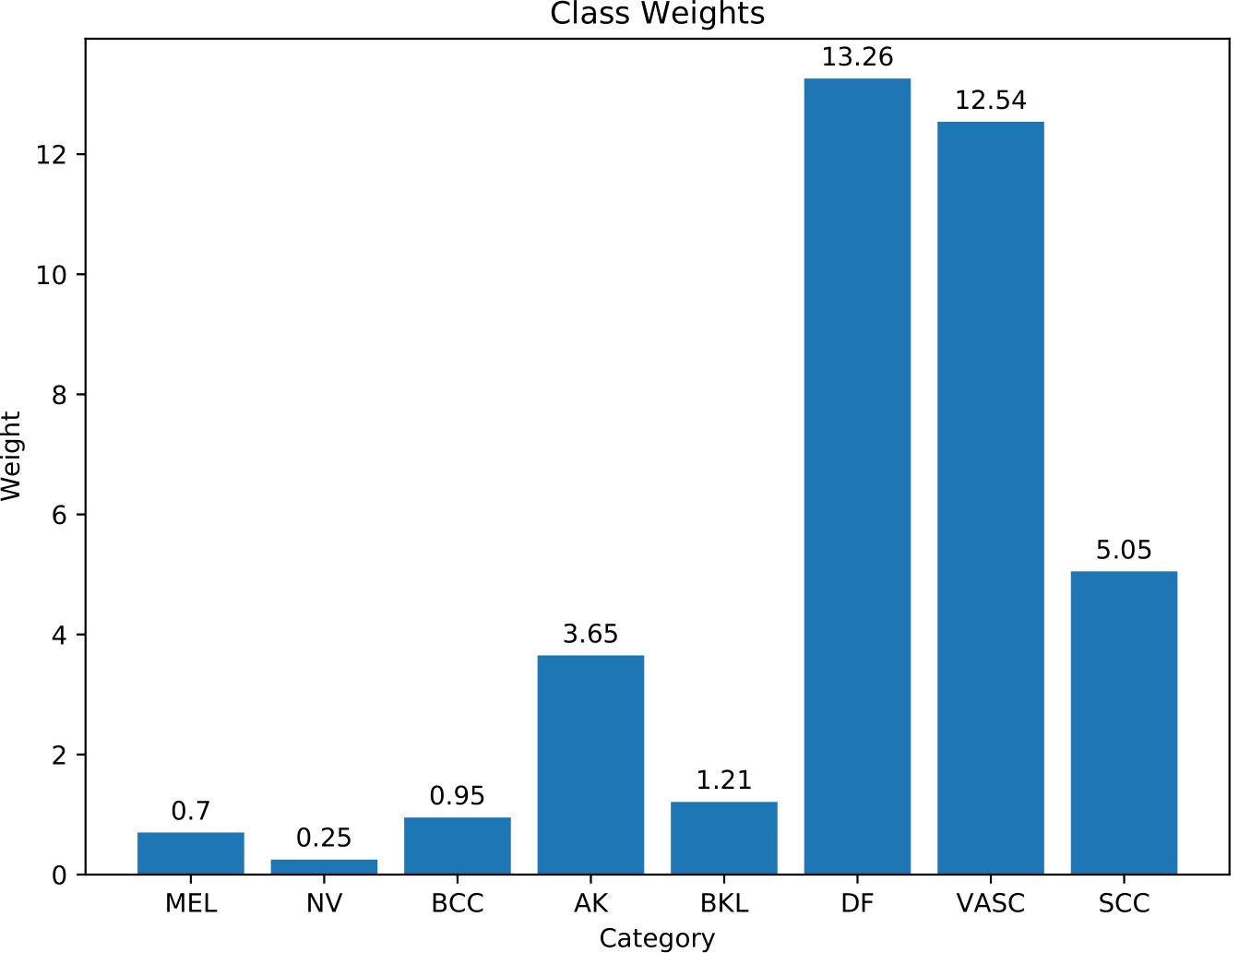
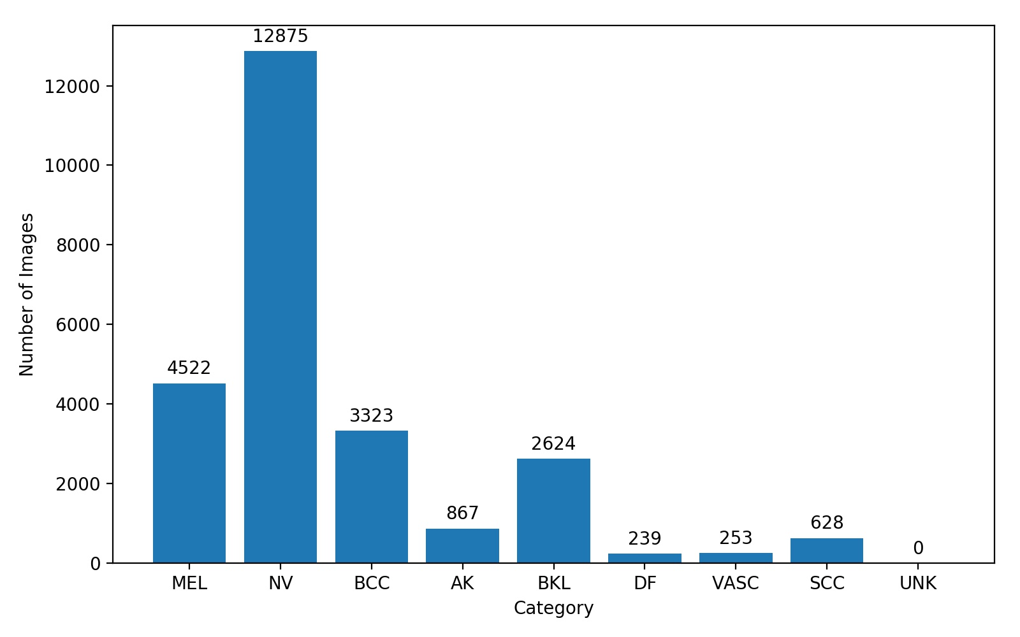
Class Imbalance
High imbalance leads to poor optimization strategies
Solution: Assign higher loss towards underrepresented classes in the loss function
Notes:
An underlying problem encontered while using this dataset is the high class imbalance, which can be troblesome as it leads optimization algorithms to optimize parameters towards well represented classes.
One solution for this problem is to change the loss function in order to give bigger weights towards underrepresented classes. Which will presumably avoid these type of bad optimization strategies. The intuition behind this method is that misclassifying a sample from an underrepresented class is going to have a much bigger impact than misclassifying a sample from an overrepresented class.

Slide 13
Structure
Motivation and Objectives
CNNs and Transfer Learning
Experimental Setup
Pre-trained Model Choice and Hyperparameter Tuning
Improving the Model’s Generalization Performance
Results Discussion and Comparison
Conclusion

Slide 14
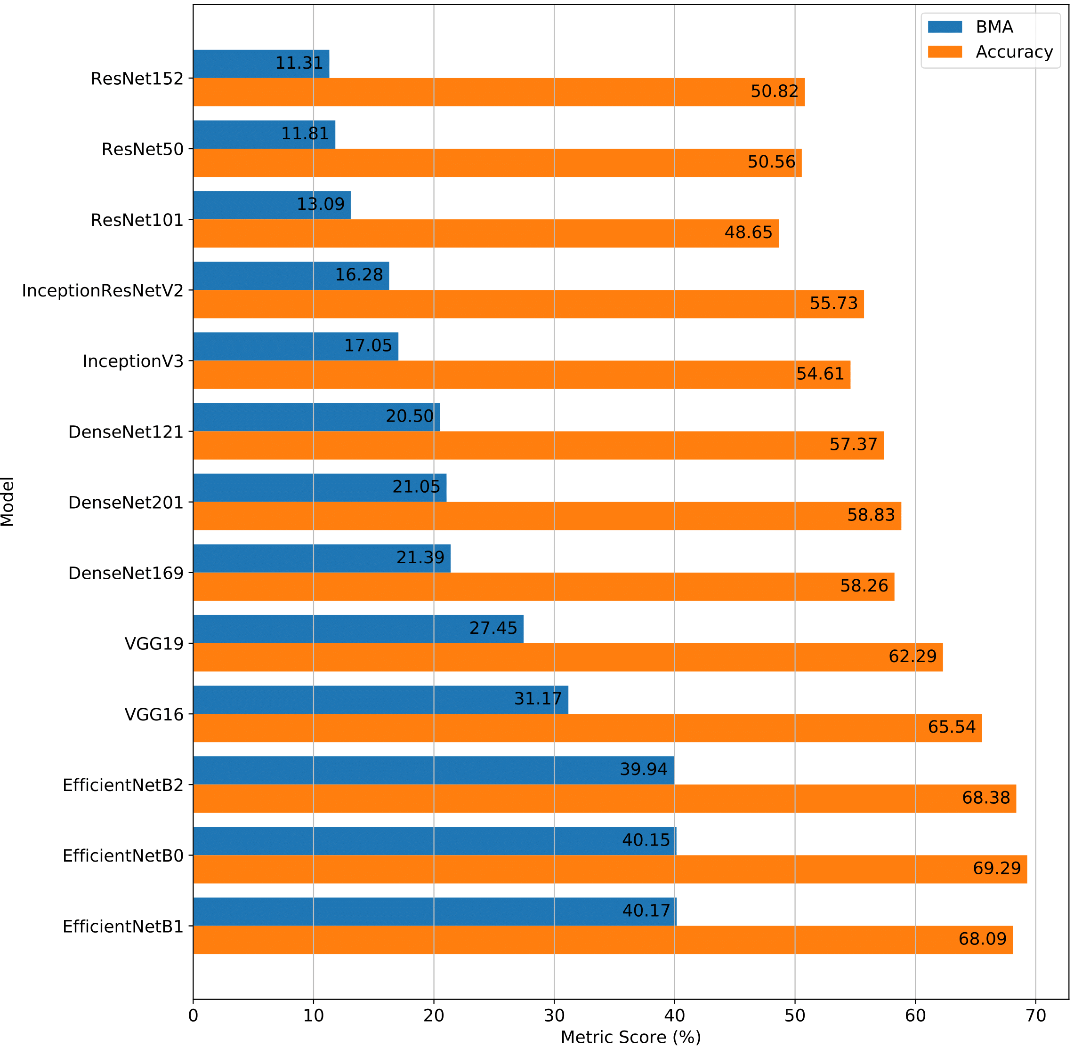
Freeze the Convolutional Base
ImageNet is substantially different from ISIC 2019
Convolutional base parameters are optimized for a very specific domain
Relatively good performance on EfficientNets
Sub-optimal transfer learning approach for skin lesion classification!
Notes:
For this set of experiments the shown results were attained with a dataset containing 5000 samples that kept the original ISIC 2019 training dataset distribution
Furthermore, this particular experiment shows the results towards applying transfer learning by only replacing and training the classifier while keeping the convolutional base unchanged.
One can observe that the results are not very good for all of these pre-trained models, presumably, because, these model’s parameters are optimized towards a very different dataset from the ISIC 2019, namely, the ImageNet

Slide 15
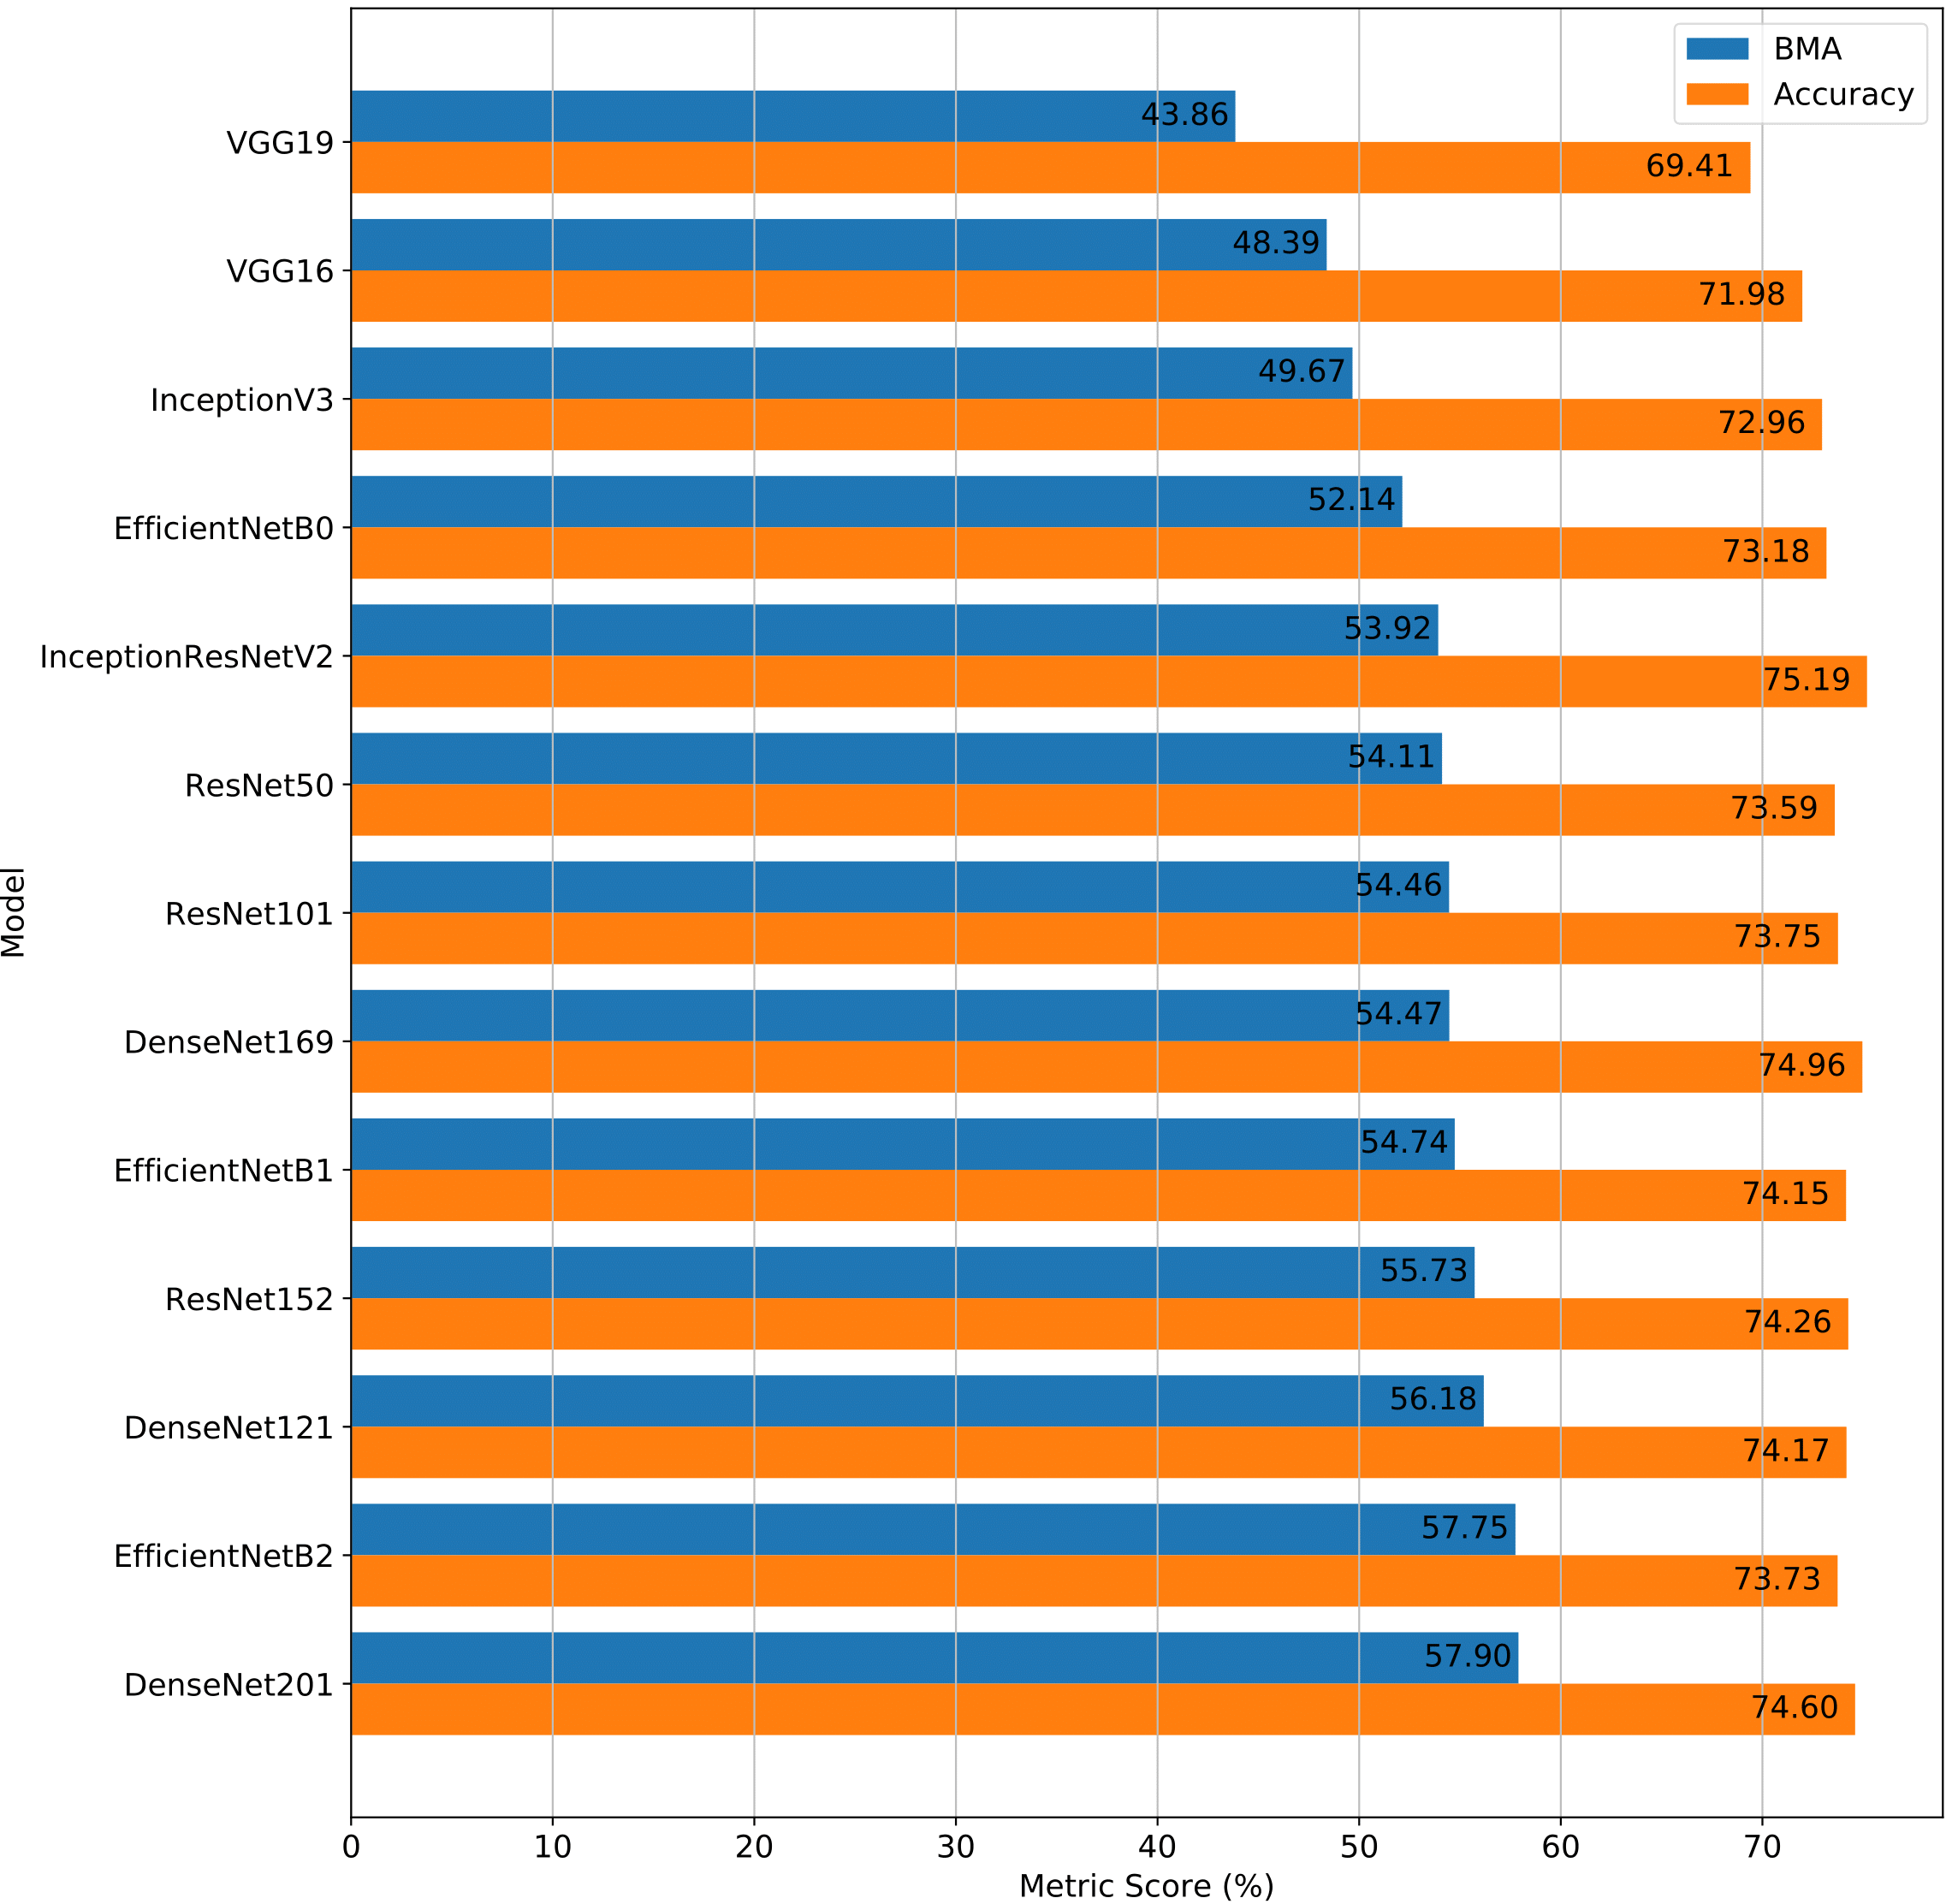
Extraction and Fine-tuning of Convolutional Layers
Knowledge obtained from the existing weights will be adapted to a new problem
Recent architectures outperform old ones
Representational depth is beneficial
Remarkable EfficientNet scalability!
The DenseNet201 is selected for future experiments.
Notes:
Another tested approach is to fine-tune the whole convolutional base while also training the classifier from scratch.
One can observe a substancial improvement from only training the classifier because the convolutional base knowledge is being re-purposed towards this new task
Furthermore, you can also see that more recent…
For this reason we are going to chose the DenseNet201 model for the next experiments.

Slide 16
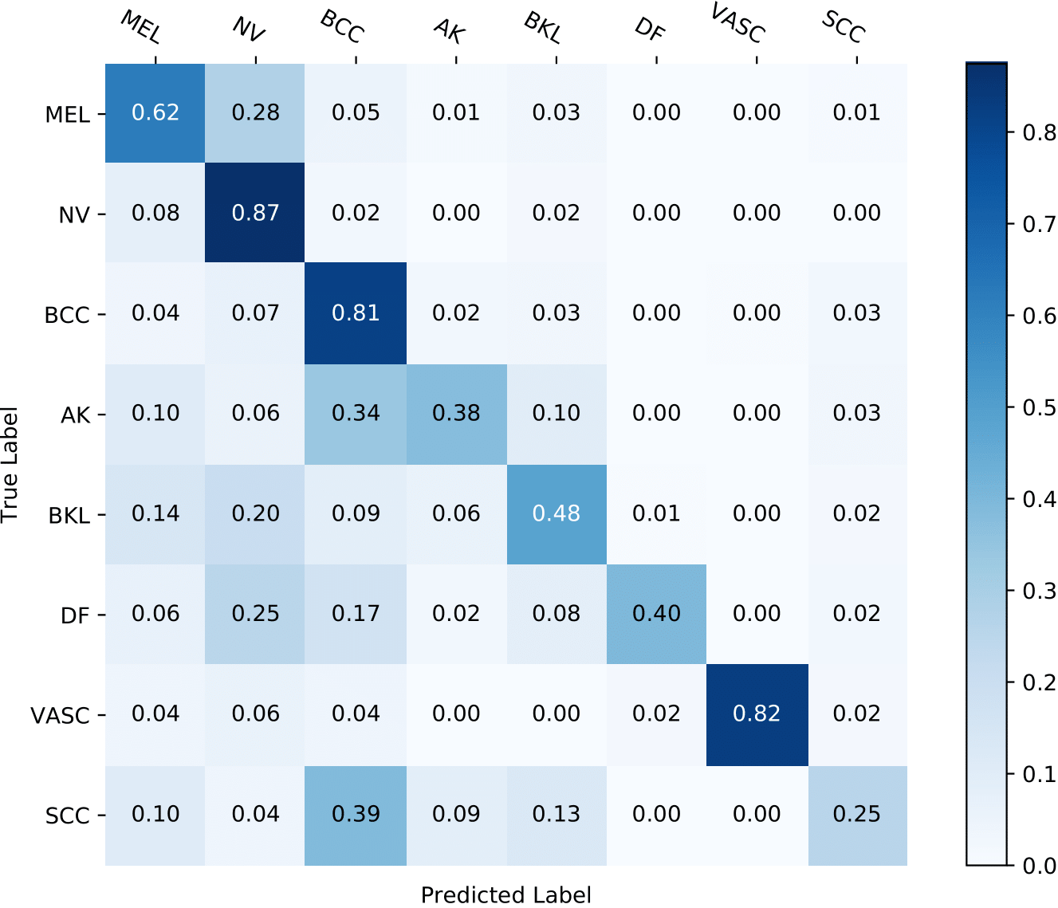
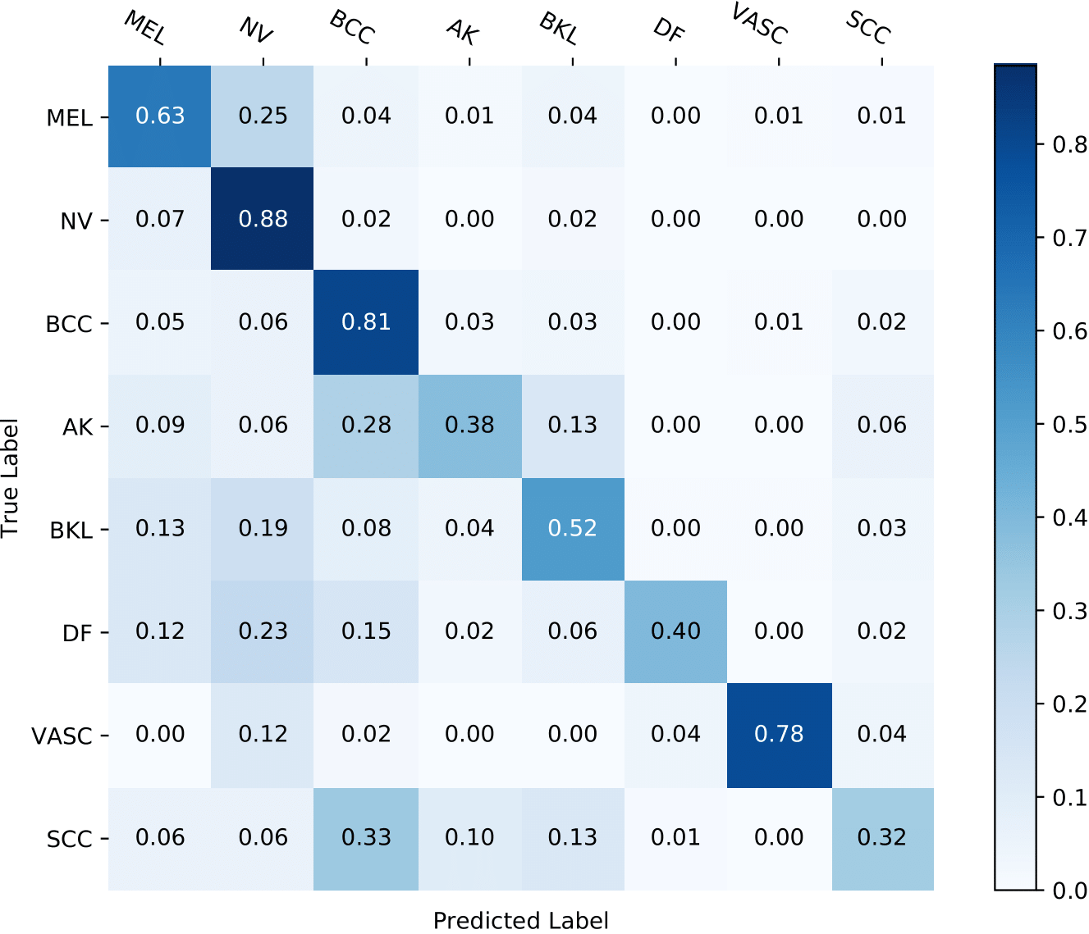
Performance Evaluation
Poor generalization performance on underrepresented classes
Hyperparameter optimization barely made an improvement
Pre-trained models are well adapted for a wide range of hyperparameters
Hypeparameter Optimization
Notes:
Now… here on the left side of this slide we are showing the confusion matrix of the predictions of this model over the test set
You can likely see that underrepresented classes are underperforming
So then i tried to improve the results through some hyperparameter optimization which produced the confusion matrix on the right of this slide.
However, the improvements were quite insignificant which just leads us to believe that….

Slide 17
Structure
Motivation and Objectives
CNNs and Transfer Learning
Experimental Setup
Pre-trained Model Choice and Hyperparameter Tuning
Improving the Model’s Generalization Performance
Results Discussion and Comparison
Conclusion
Notes:
So from this results there is a clear need to improve the generalization performance of our model

Slide 18
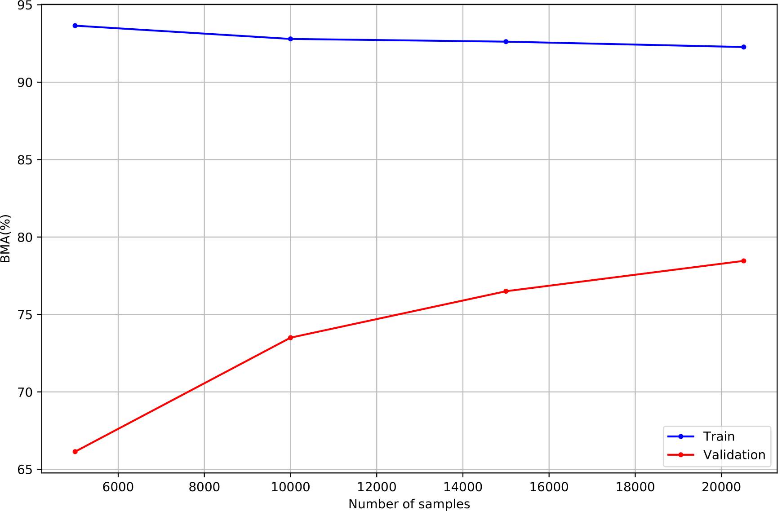
Impact of Dataset Size
Less overfitting
Better generalization performance
More samples are needed to further reduce overfitting
How to further increase performance?

Slide 19
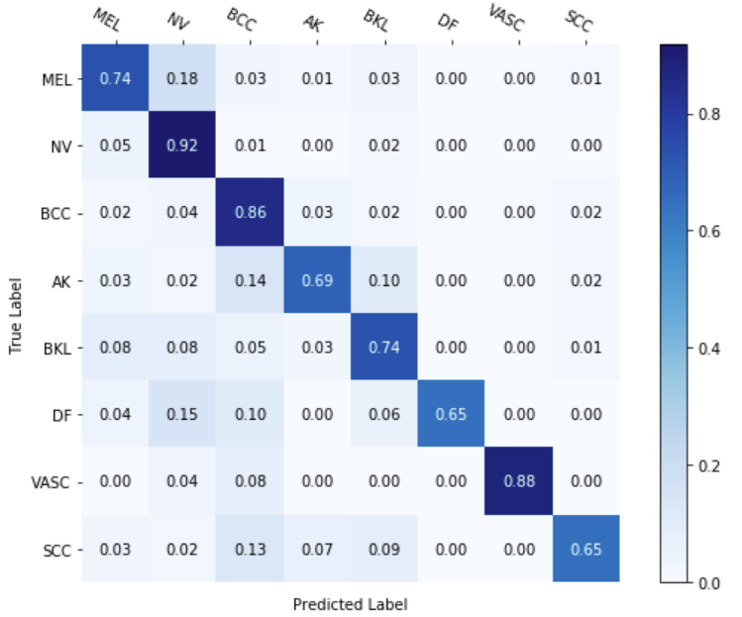
5000 samples vs 20518 samples

Slide 20
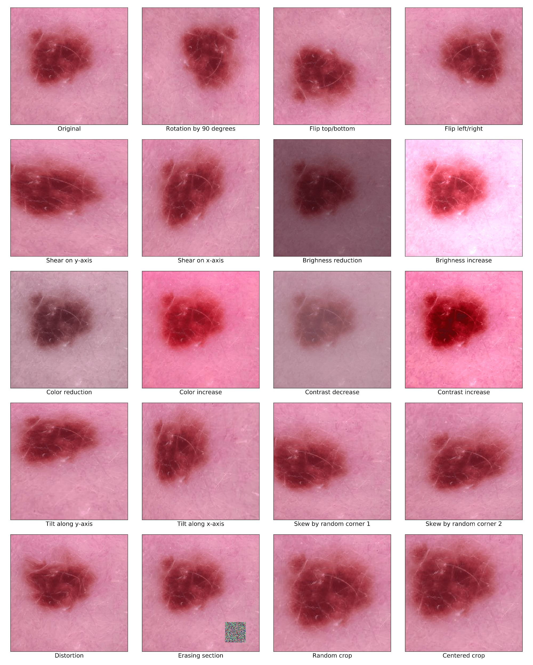
Data Augmentation Groups
Group 0: No augmentation techniques
Group 1: Slight variations to the original image;
Group 2: Augmentation techniques of group 1 plus some adjustments on pixel intensities
Group 3: Augmentation techniques of group 1 plus perspective transformations
Group 4: Augmentation techniques of group 1 plus noise induction augmentation techniques

Slide 21
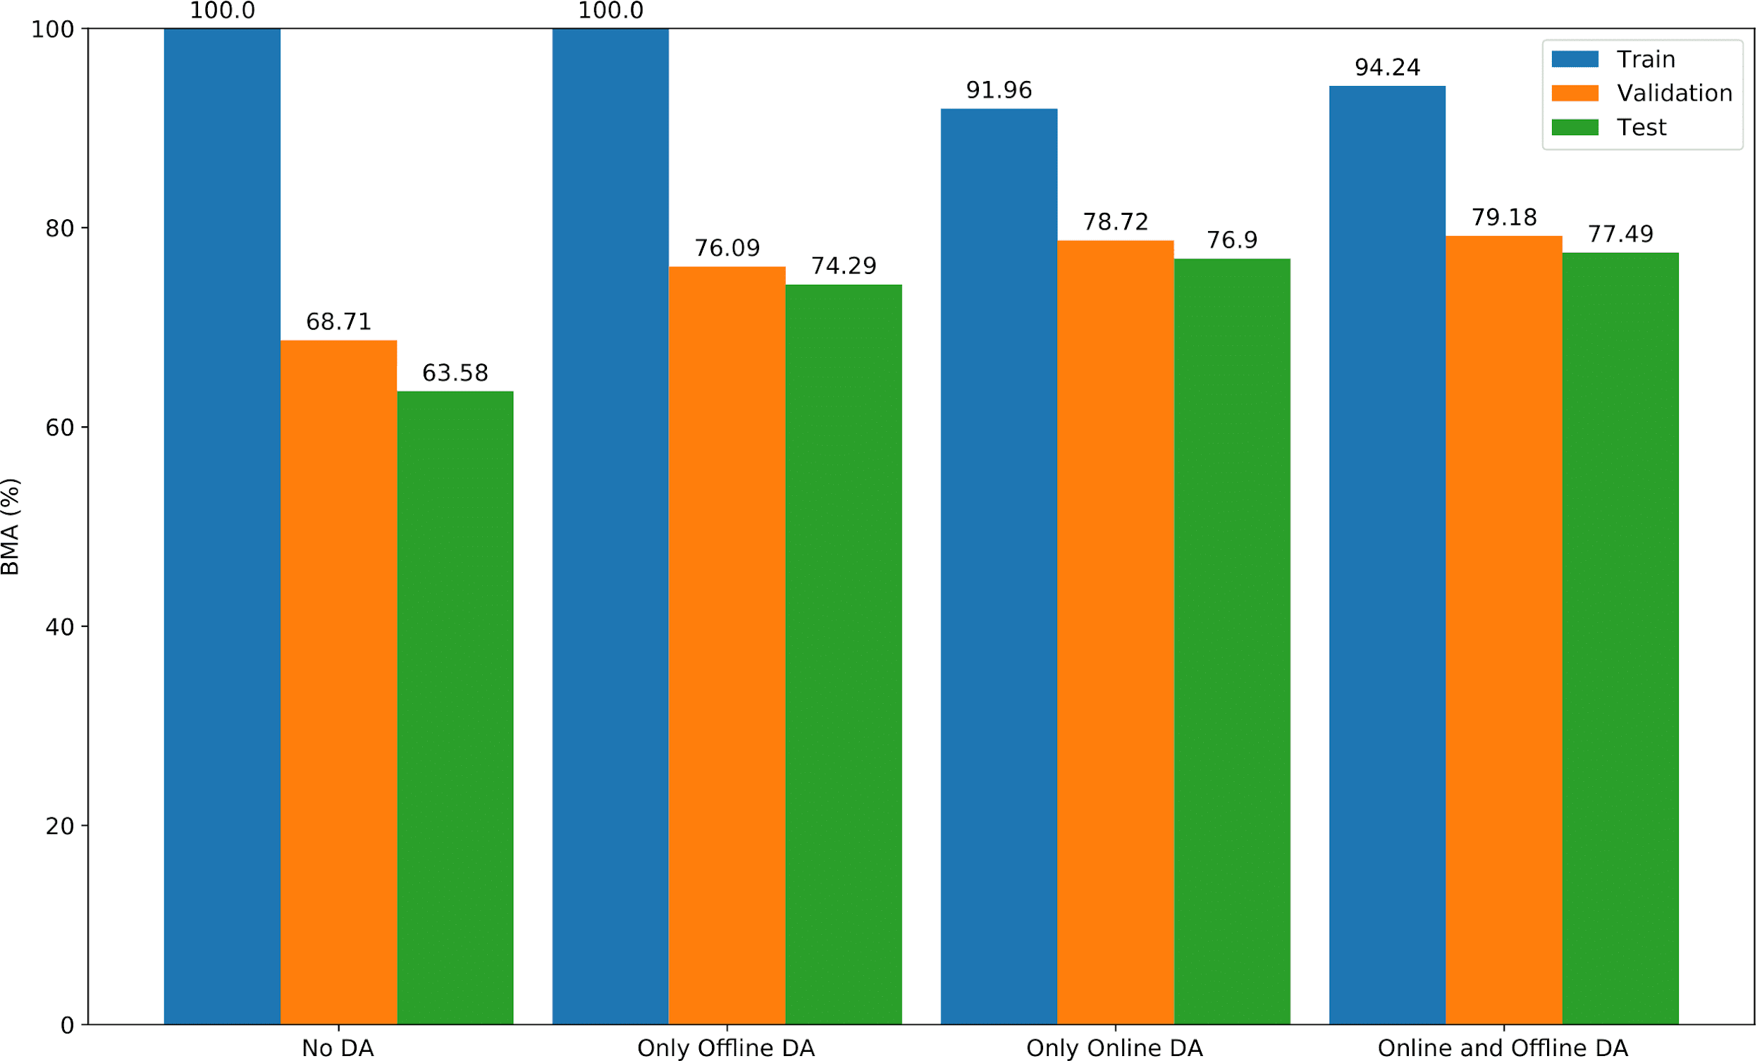
Offline vs Online Data Augmentation
Offline data augmentation used to class balance and oversample the dataset
Online data augmentation used to reduce overfitting while training
Combining both reduces overfitting and improves generalization performance

Slide 22
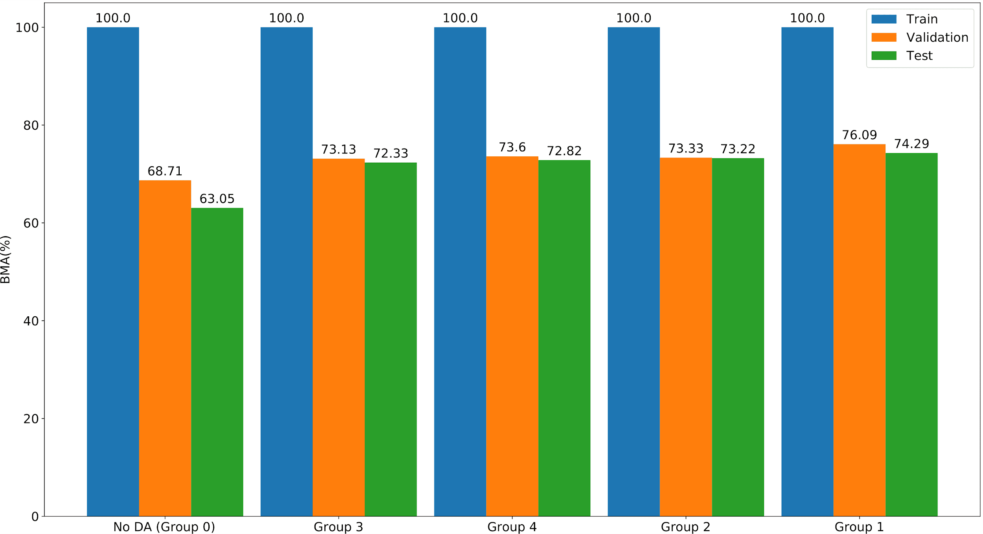
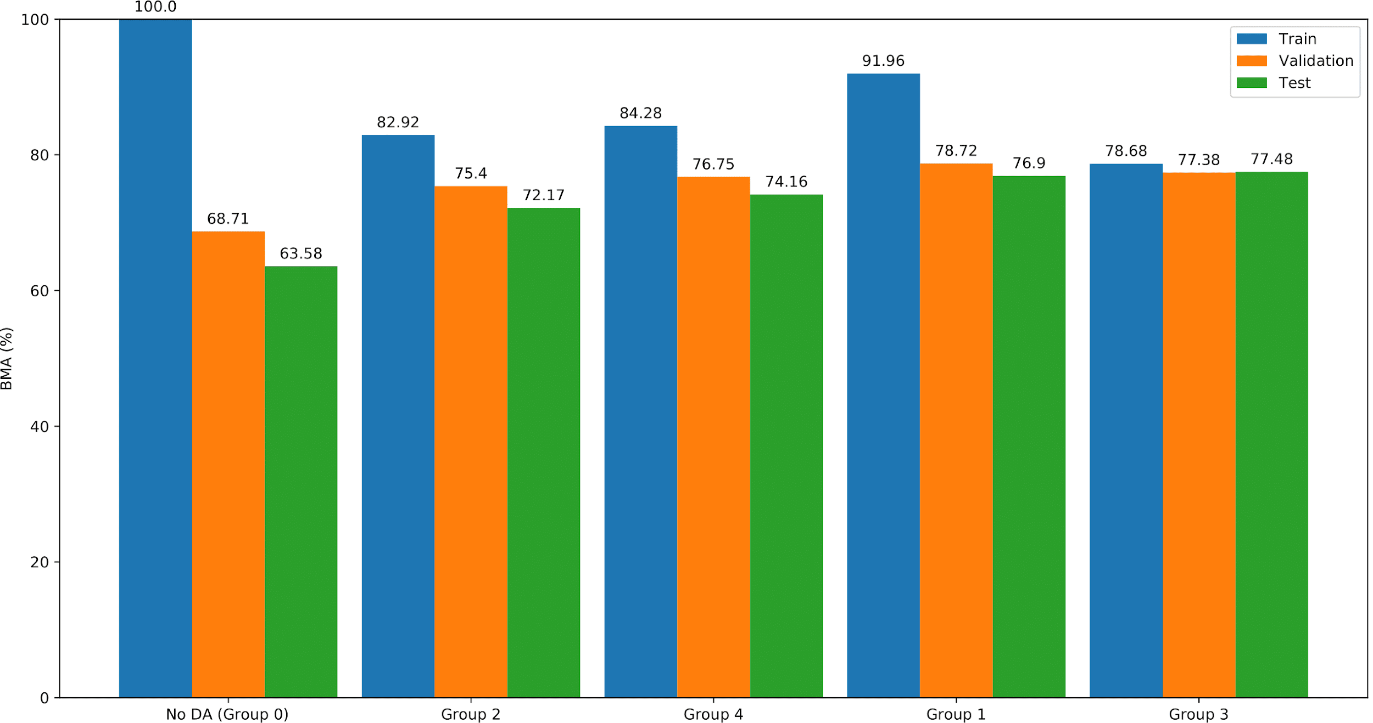
Augmentation Group Results
Offline:
Complex augmentation remove important information
Simpler augmentations perform better
Online:
Group 2 and 4 reduce overfitting but also reduce train, validation and test BMA
Group 3 dramatically reduces overfitting
Results are related to the way online data augmentation works
Complex augmentations help generalize knowledge

Slide 23
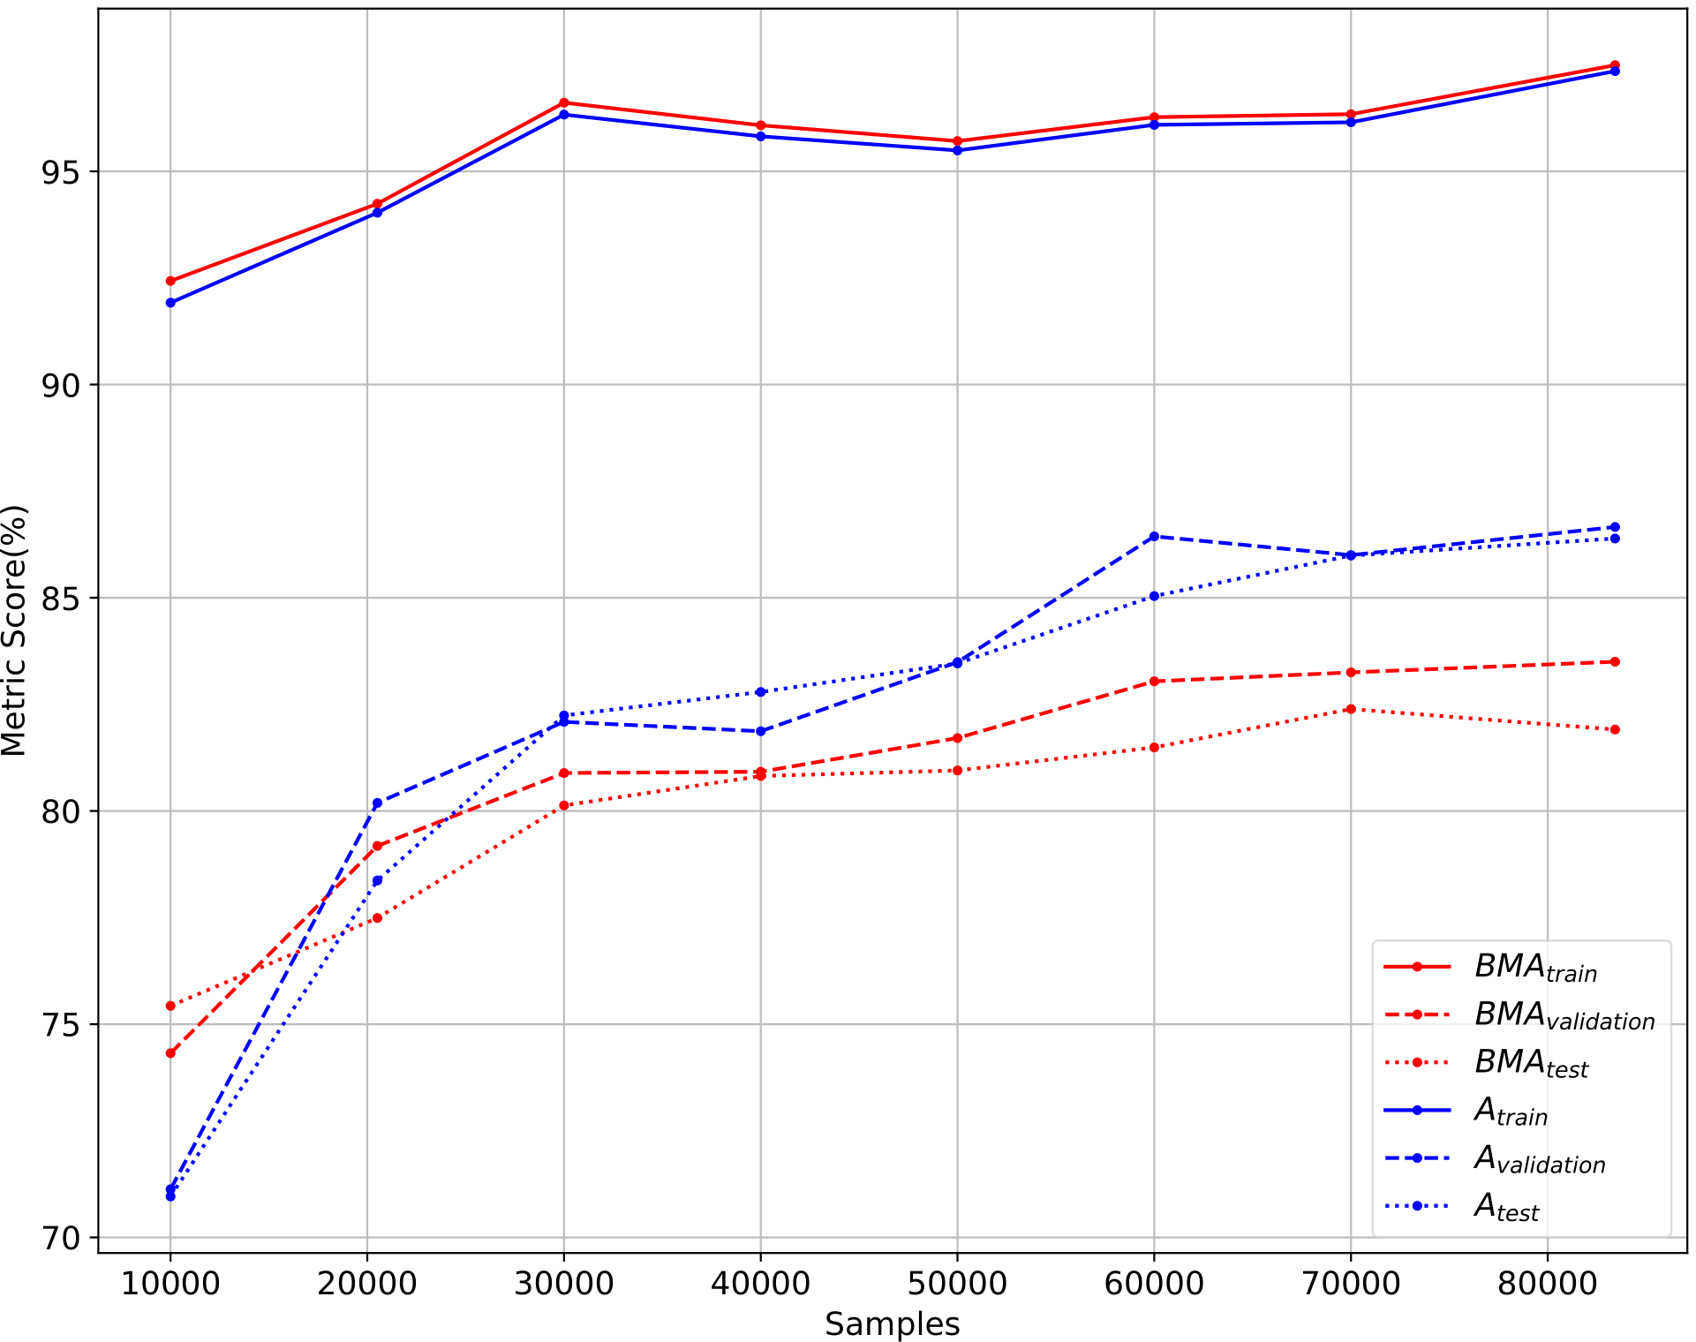
Class Balancing
Oversampling through augmentation group 1
Performance increase on underrepresented classes
Gap between BMA and accuracy

Slide 24
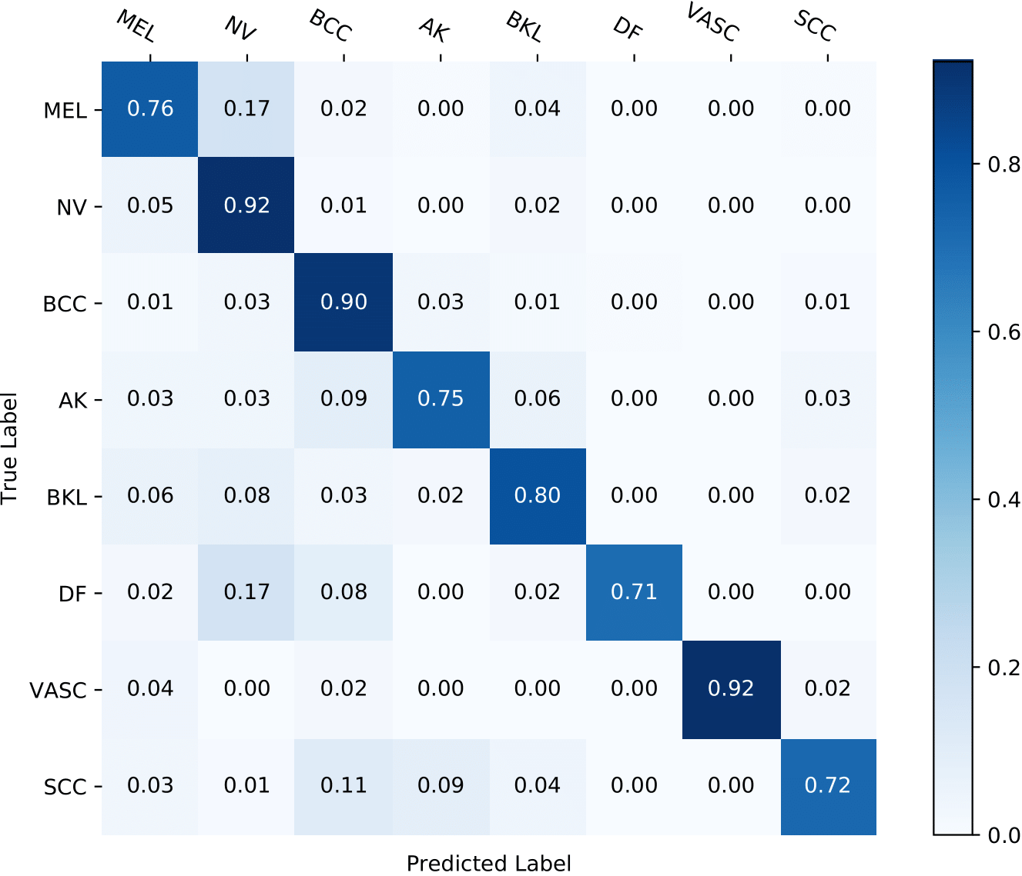
Original Training Dataset (20518 samples) vs Synthetic Class-Balanced Dataset (83432 samples)

Slide 25
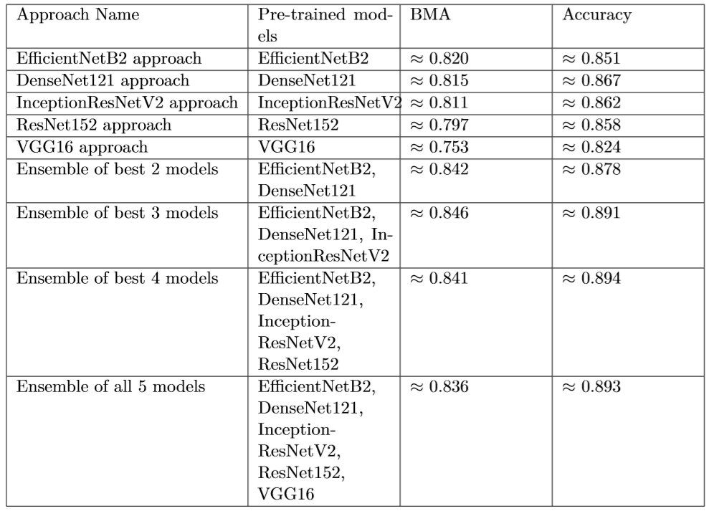
Ensemble
Considerable improvement from single-model performance
More models are not necessarily better
Very useful for benchmark challenges

Slide 26
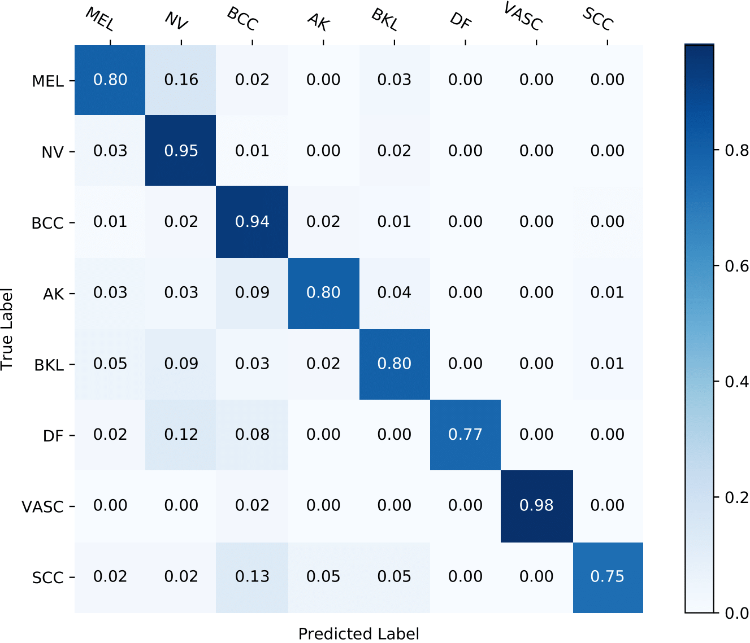
Single Model vs Ensemble of Best Three Models

Slide 27
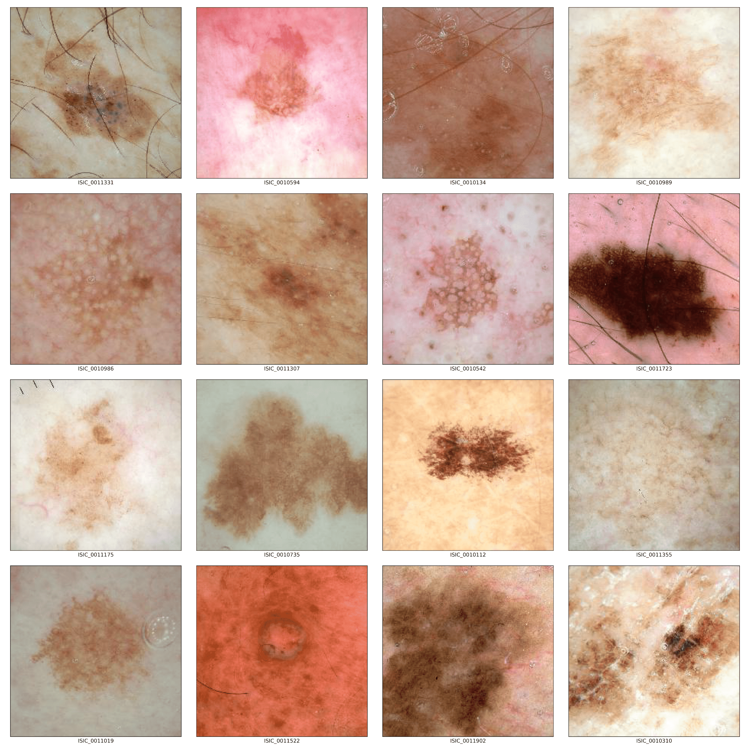
Out of Training Distribution Samples
Composed of different types of lesions from ISIC Archive, not belonging to the original distribution
Same preliminary steps (i.e., pre-processing and split)
Notes:
So, as i’ve previously said the ISIC 2019 comitte wanted to shift the research focus towards the detection of out of training distribution samples in the test set. However, no dataset is provided for this out of distribution samples by the ISIC organization.
Therefore, in order to assess the performance of different out of training distribution detection methods, we gathered our own set of out of distribution samples. These are spread across different classes not present on the original ISIC 2019 dataset and belong to the ISIC archive.
You can see some examples on the right side of this slide.

Slide 28
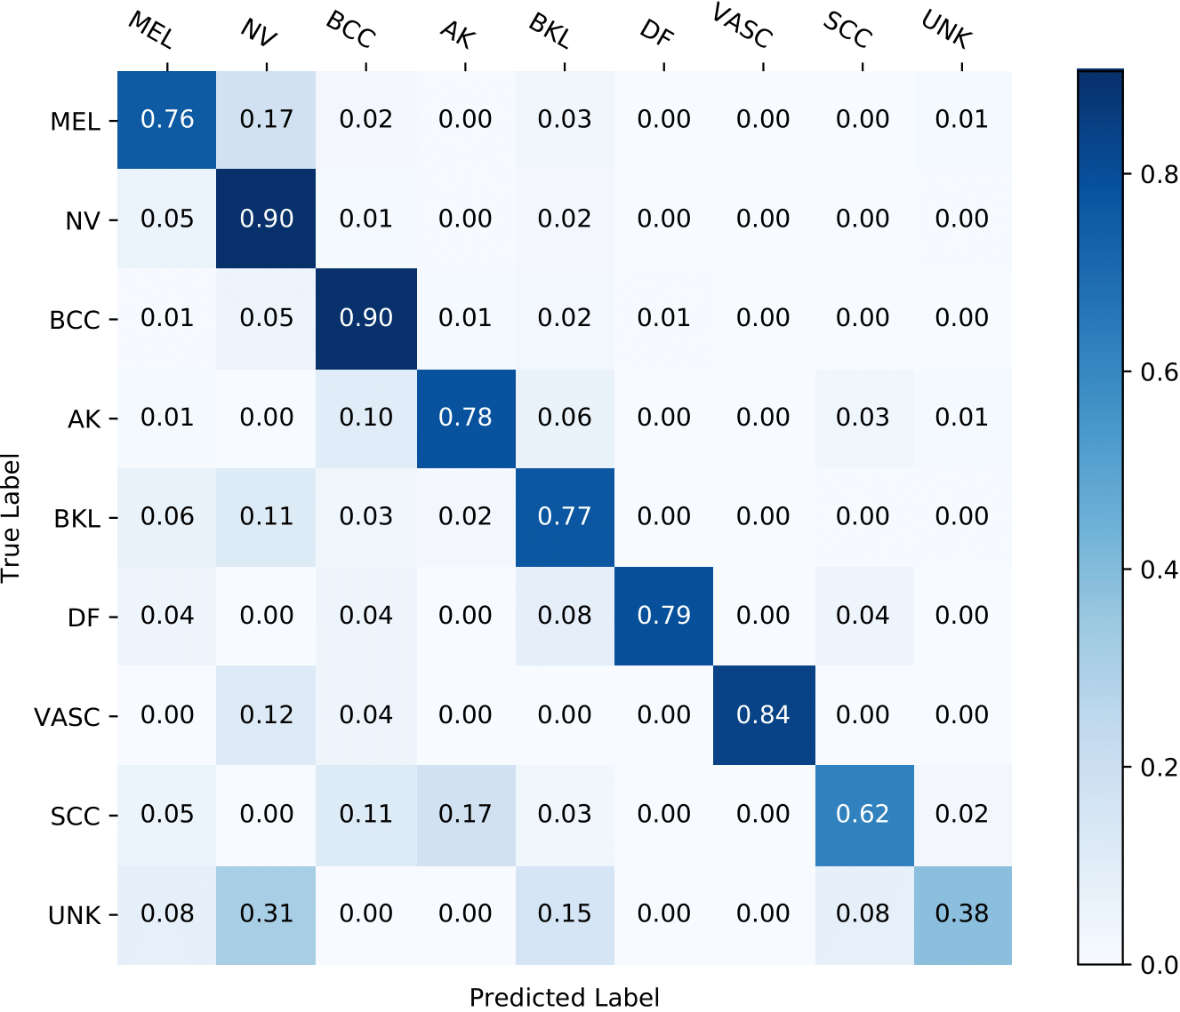
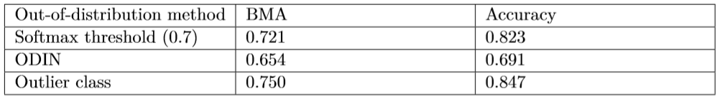
Out of training distribution detection
Methods from the literature:
Top-1 softmax thresholding
Out-of-DIstribution detector for Neural networks (ODIN)
Outlier Class
Outlier class outperforms other approaches
Some limitations:
Low generalization performance:
Small set of samples
Clearly defined distribution
Bias in the training and test sets
Notes:
So we tried 3 different methods to detect out of distribution samples:
2 of them are based on the softmax predictions, namely,:
Top-1 softmax thresholding
ODIN
Both of which didn’t perform that well, which we presume that is related to the fact that our in-distribution samples are very similar to the out-of-distribution samples.
Another tested method which was also employed by the ISIC 2019 winner was to re-train the model with a 9th class trained with the set of the aforementioned samples.
This method outperforms the other 2 as seen in this table at the bottom of this slide but this approach has its limitations, namely:
Low generalization performance as seen in this confusion matrix on the right of this slide…
And…. there might be some bias in the train and test sets due to the inhability to indentify a proper distribution for this class.

Slide 29
Structure
Motivation and Objectives
CNNs and Transfer Learning
Experimental Setup
Pre-trained Model Choice and Hyperparameter Tuning
Improving the Model’s Generalization Performance
Results Discussion and Comparison
Conclusion

Slide 30
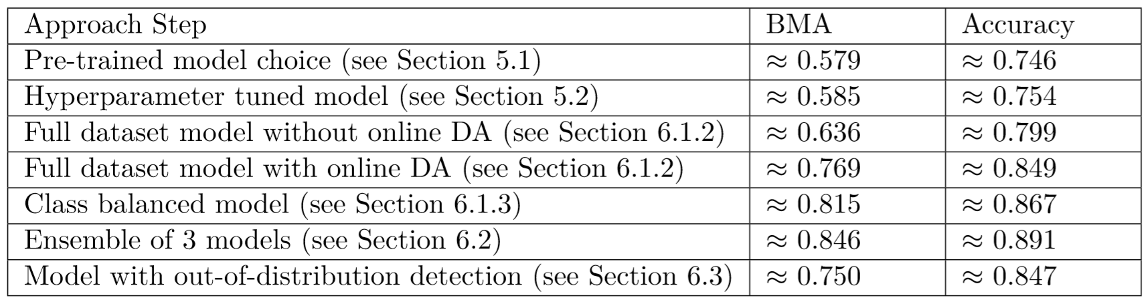
Results Discussion
Important methods to improve generalization performance:
Transfer learning methodology + CNN pre-trained model
Dataset size
Data augmentation
Methods to consider:
Hyperparameter tuning
Ensemble learning
Out-of-training distribution detection methods

Slide 31
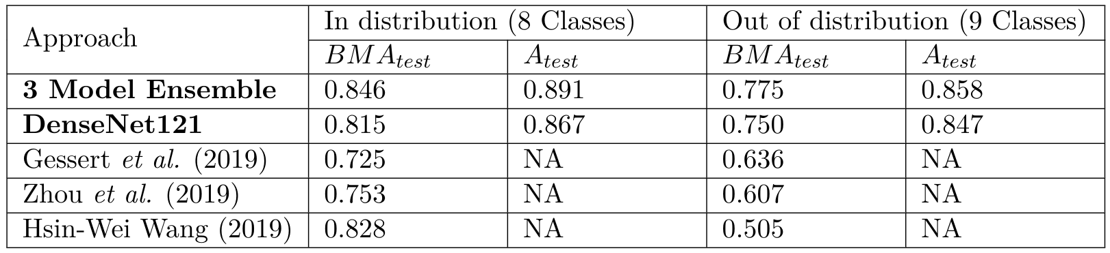
Results Comparison
State of the art results on both single-model and multi-model performance for 8-class classification
9-class classification tested with a different test set

Slide 32
Structure
Motivation and Objectives
CNNs and Transfer Learning
Experimental Setup
Pre-trained Model Choice and Hyperparameter Tuning
Improving the Model’s Generalization Performance
Results Discussion and Comparison
Conclusion

Slide 33
Key Takeaways
Fine-tuning the convolutional base is the optimal approach for skin lesion classification
The choice of the pre-trained model's architecture can have a substantial impact
Pre-trained models are well optimized for a wide range of hyperparameters
The augmentation techniques used should be carefully selected
Online data augmentation emerges as a method to reduce overfitting
Ensembling multiple models is useful for benchmarks
Re-training the model with an outlier class can become a viable approach as an out of training distribution detection method
Notes:
Finally, some key takeaways can be highlighted about our experiment results. Namely:
First of, fine tuning the convolutional base is the optimal method to adapt pre-trained models for skin lesion classification.
Moreover, one should carefully choose the pre-trained model as it can have a substantial impact on performance.
However, these pre-trained models are well adapted for a wide range of hyperparameters which is a great property for machine learning beginners.
Another takeway is that augmentation can significantly improve the performance but the augmentation techniques should be carefully selected for both online and offline data augmentation
In this context, online data augmentation is a great method to reduce overfitting and offline is a great method to improve performance on underrepresented classes.
Although we got some improvements from using ensemble learning these types of models are not very practical for real world usage.
Finally, re-training a model with an outclier class can become a viable approach for out-of-training distribution detection as long as there is more samples for this class.

Slide 34
Future Research
Further research towards online data augmentation:
Explore other augmentation groups (e.g., GANs)
Study the impact on other datasets (e.g., ISIC 2020 challenge dataset)
Lack of interpretability/explainability of deep learning models:
Hierarchical classiﬁer
Display kernel ﬁlters during the inference phase
Further research is required to integrate these models into the clinical workflow:
Get dermatology professionals involved
Focus on practicality rather than performance
Notes:
Additionally, some future research can be made towards some of methods that i mentioned througout this work.
So, one can further research online data augmentation with different groups and in different datasets
Also, two properties were left out of our approaches towards automated skin lesion diagnosis, namely:
Interpretability of our models which is key to increase the trust in these types of systems.
And the Integration in the clinical workflow of medical professionals because ultematelly these classifiers aim to augment a dermatologist’s capabilities rather than replace them.

Slide 35
Thank You
Notes:
So, thank you so much for tuning into this presentation. I hope you liked it and learned something from it! And im not waiting from some of your questions.

